Slide 1
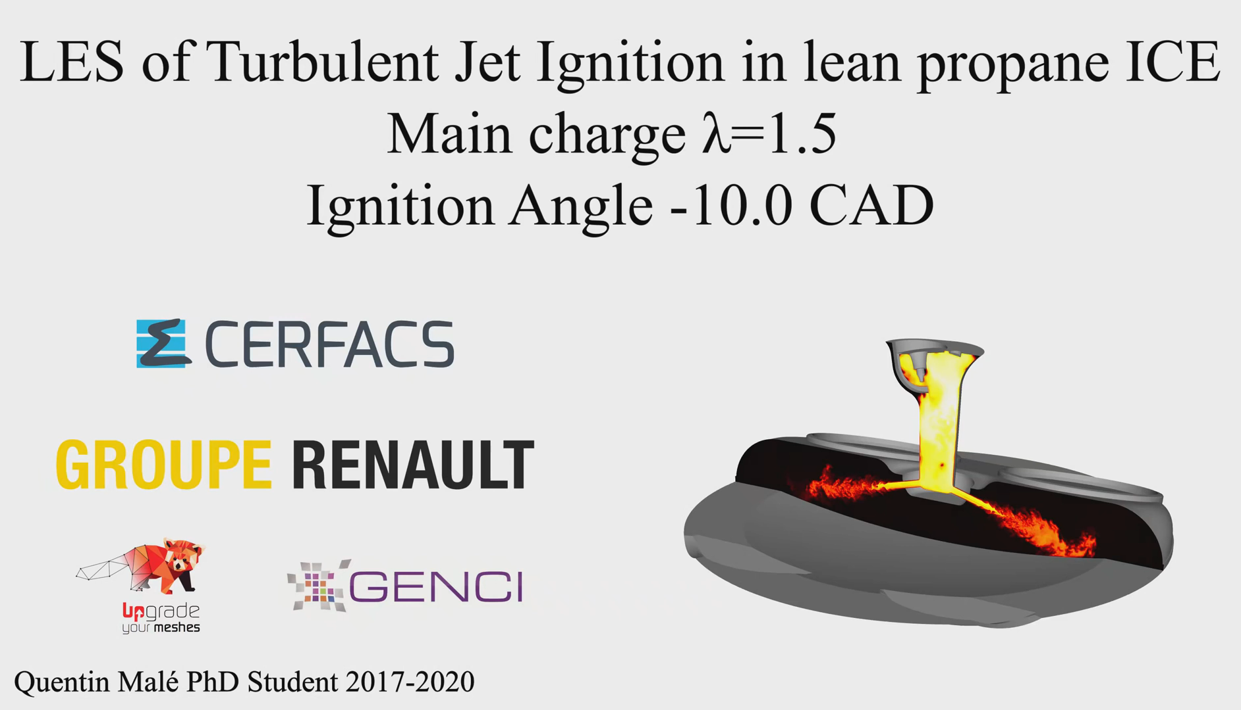
Thermodynamics
An Engineering Approach
Lecture 2: Energy and the First Law of Thermodynamics
Qiang Cheng (Jonny)

Slide 2
Learning Outcomes
When you complete your study of this chapter, you will be able to…
explain key concepts related to energy and the first law of thermodynamics . . . including internal, kinetic, and potential energy, work and power, heat transfer and heat transfer modes, heat transfer rate, power cycle, refrigeration cycle, and heat pump cycle.
analyze closed systems including applying energy balances, appropriately modeling the case at hand, and correctly observing sign conventions for work and heat transfer.
conduct energy analyses of systems undergoing thermodynamic cycles, evaluating as appropriate thermal efficiencies of power cycles and coefficients of performance of refrigeration and heat pump cycles.
Notes:
Heat is energy can be converted from one form to another, or transferred from one object to another. For example, a stove burner converts electrical energy to heat and conducts that energy through the pot to the water. This increases the kinetic energy of the water molecules, causing them to move faster and faster. At a certain temperature (the boiling point), the atoms have gained enough energy to break free of the molecular bonds of the liquid and escape as vapor.

Slide 3
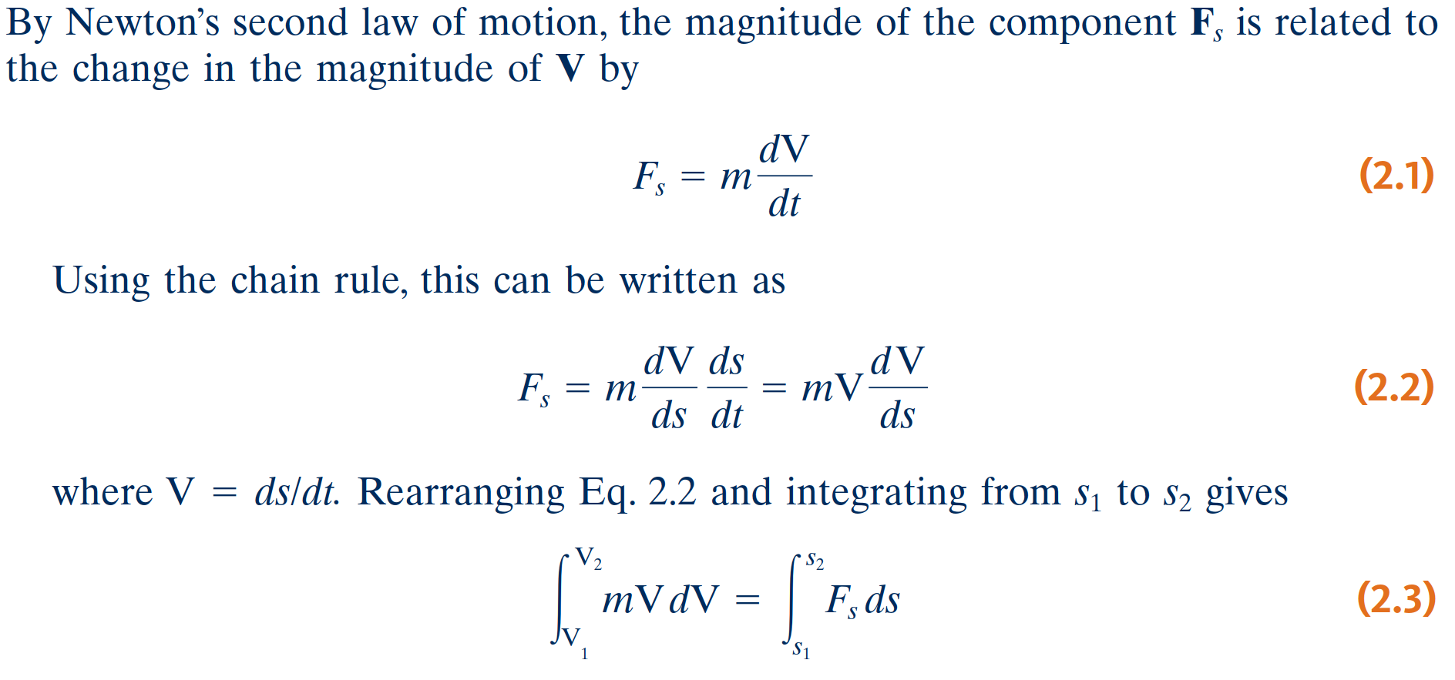
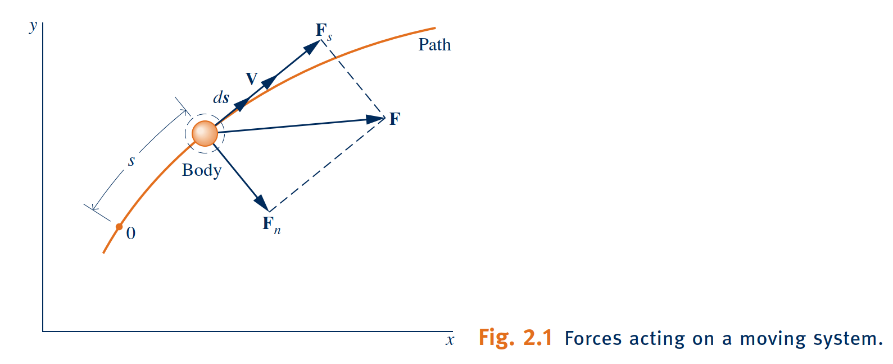
Reviewing Mechanical Concepts of Energy
Work and Kinetic Energy

Slide 4
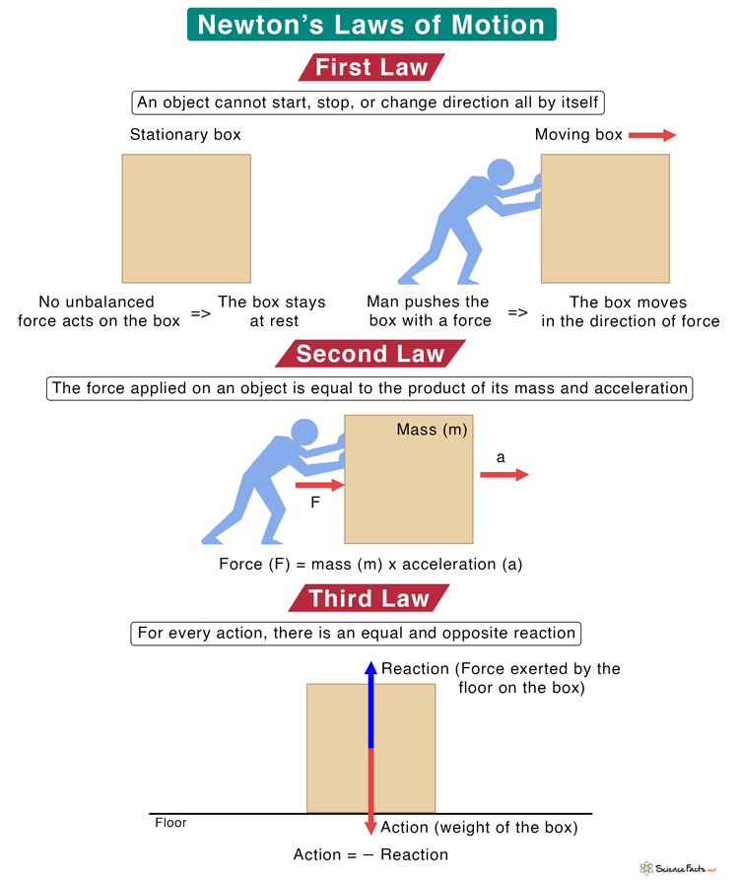
Reviewing Mechanical Concepts of Energy
Work and Kinetic Energy

Slide 5
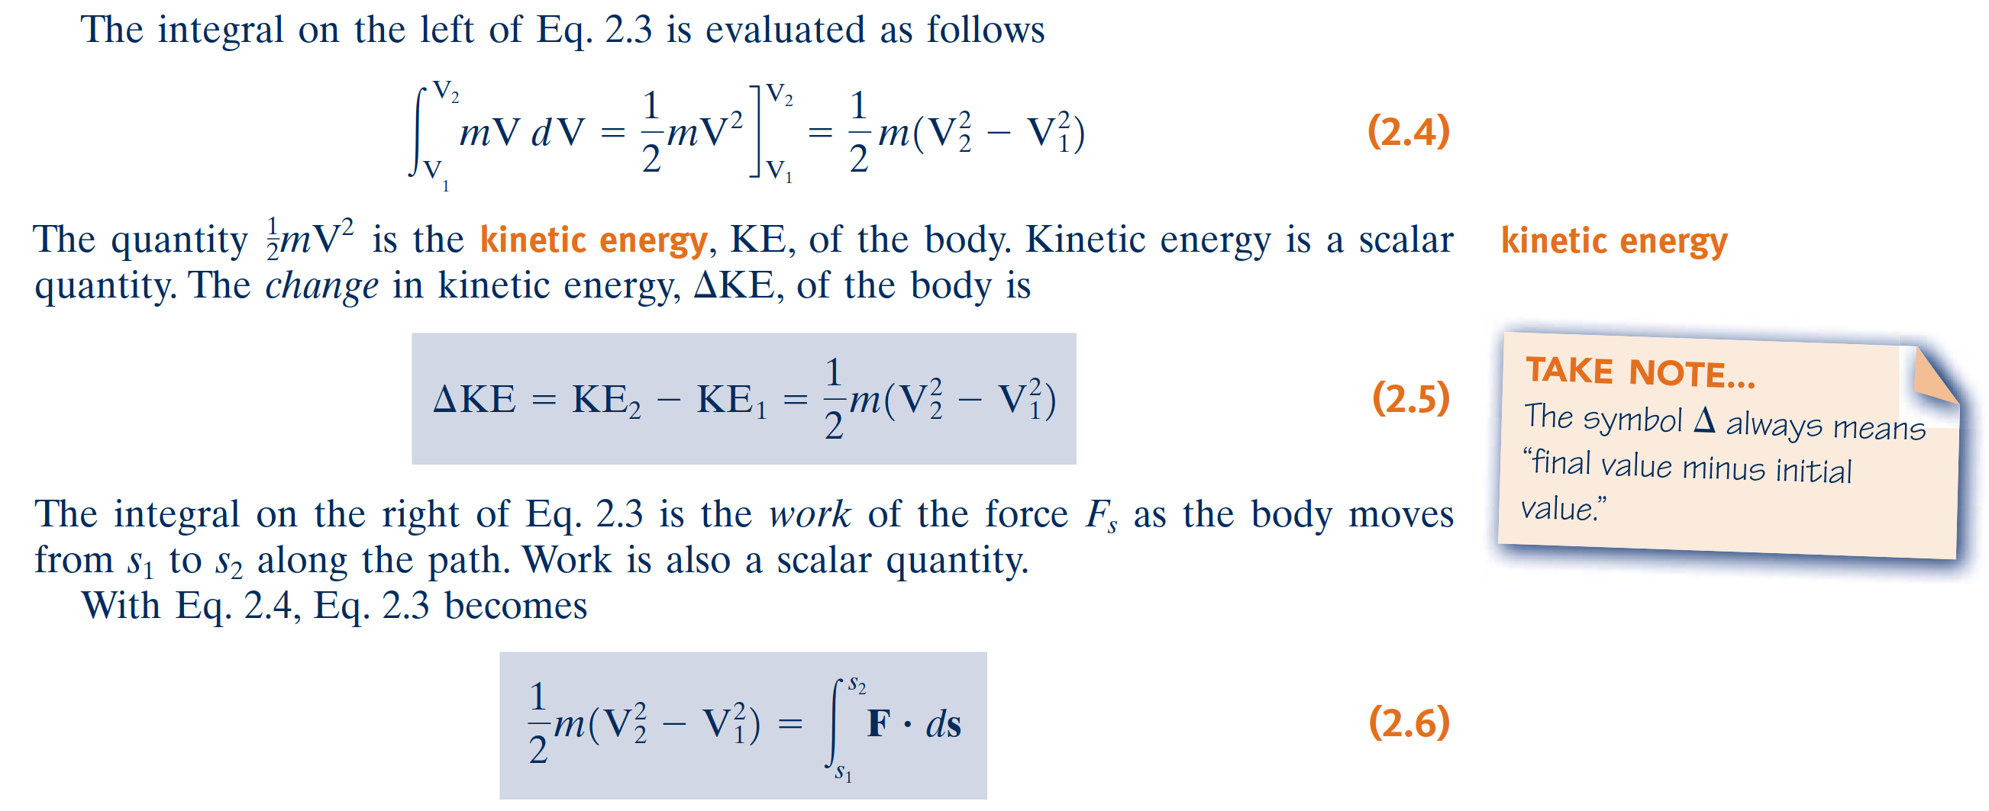
Reviewing Mechanical Concepts of Energy

Slide 6
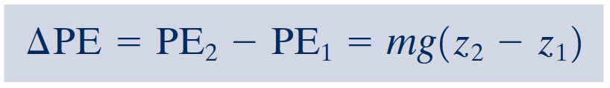
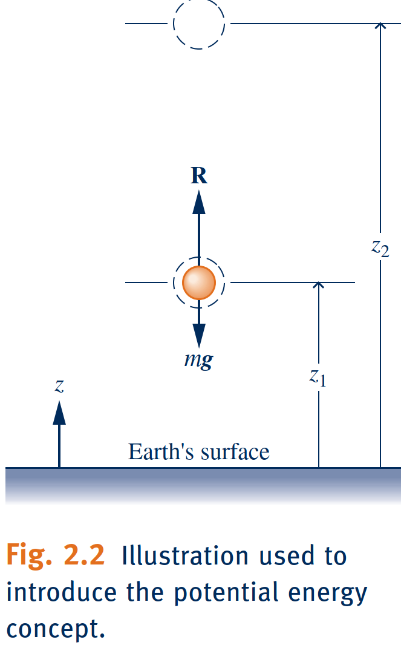
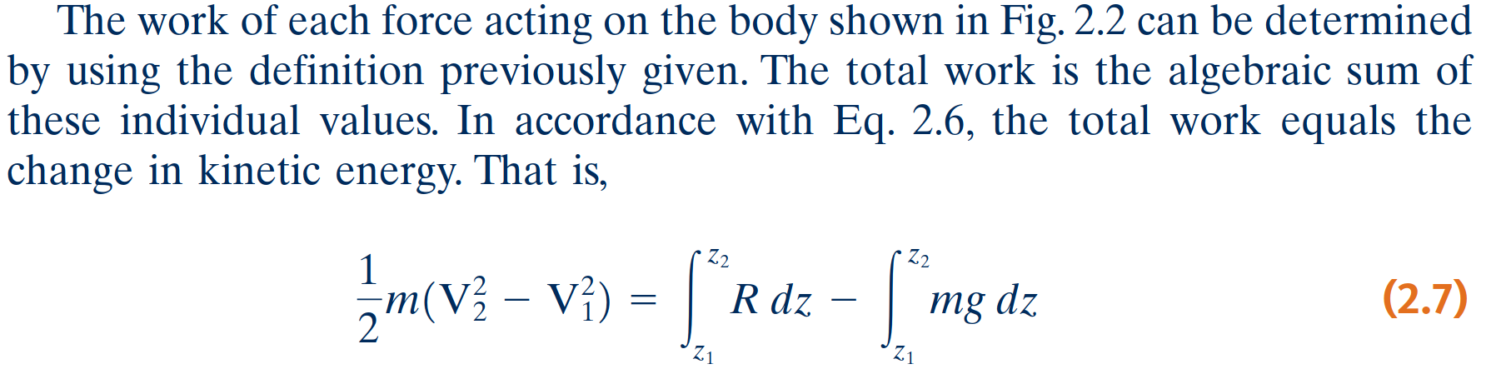
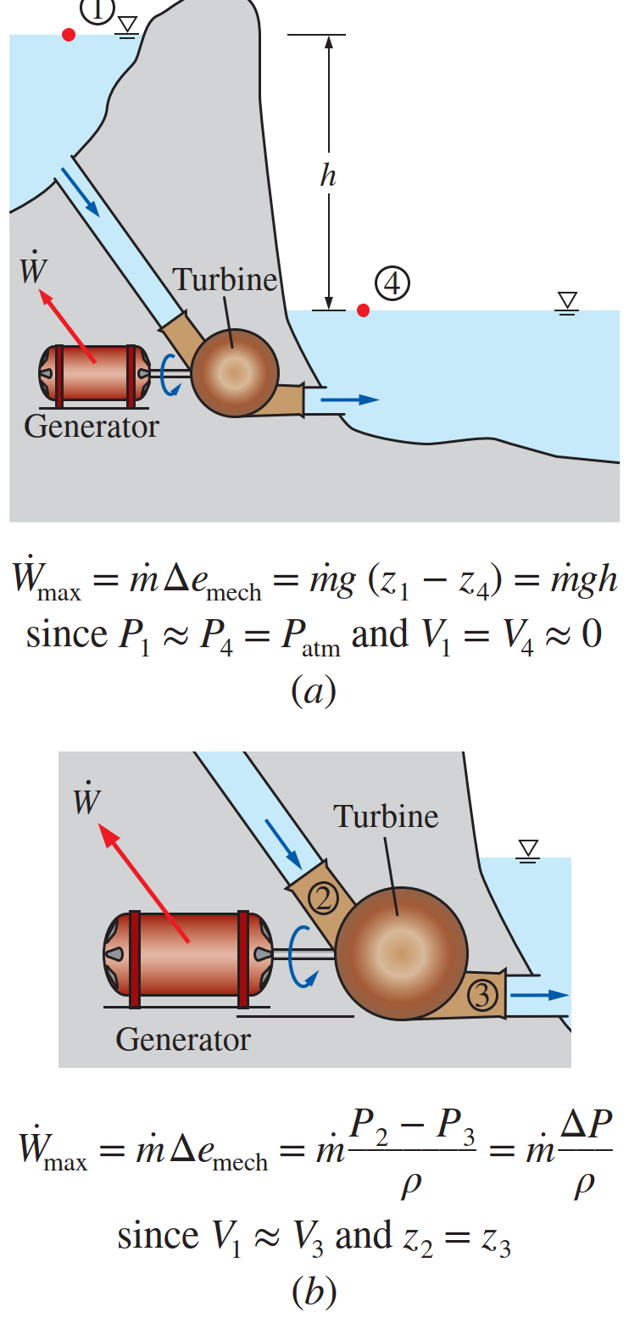
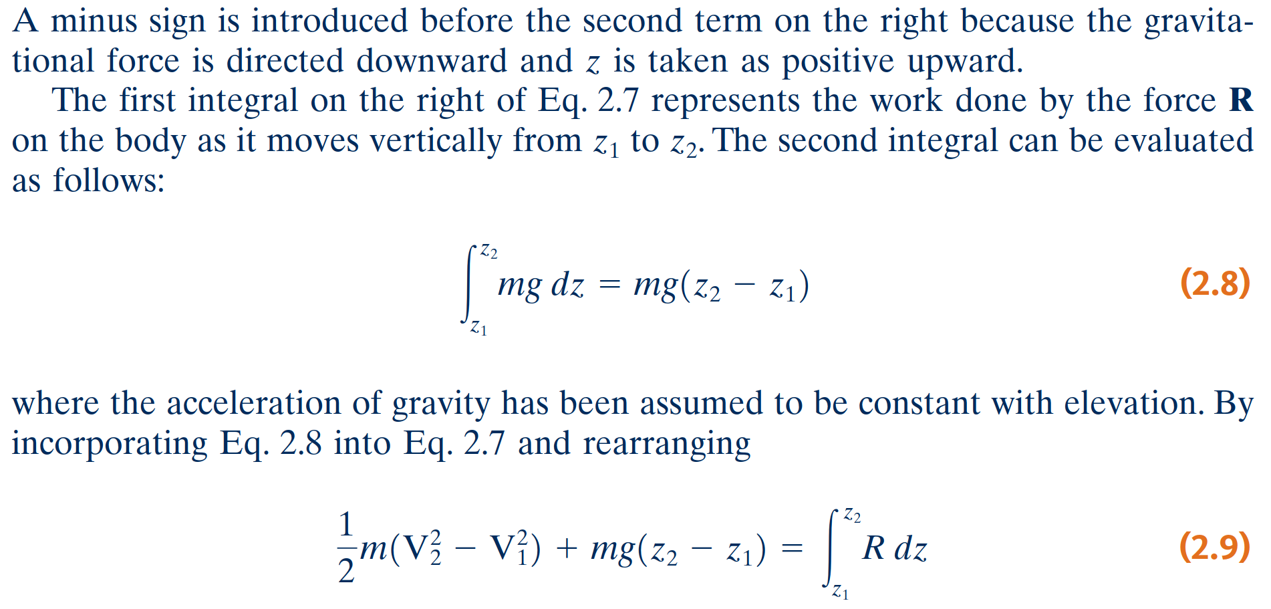
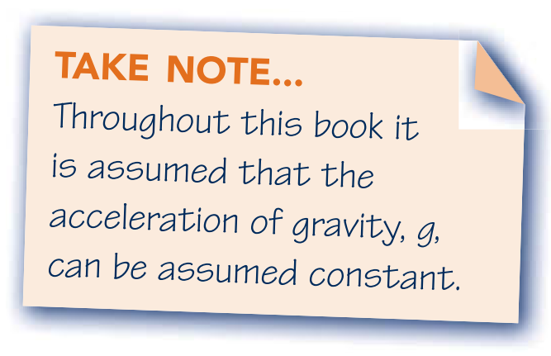
Potential Energy
gravitational potential energy
The quantity mgz is the gravitational potential energy, PE. The change in gravitational potential energy, ΔPE, is

Slide 7
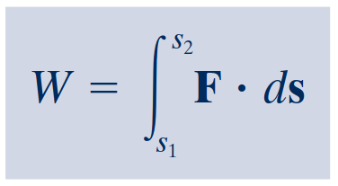
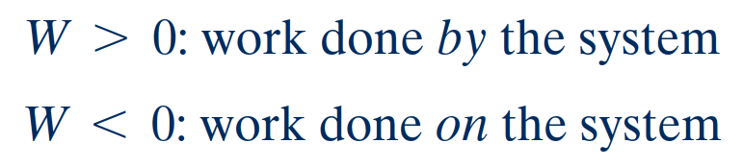
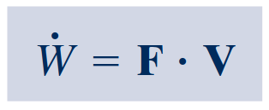
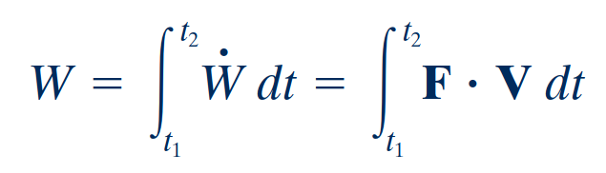
Broadening Our Understanding of Work
The work W done by, or on, a system evaluated in terms of macroscopically observable forces and displacements is
A particular interaction is categorized as a work interaction if it satisfies the following criterion, which can be considered the thermodynamic definition of work: Work is done by a system on its surroundings if the sole effect on everything external to the system could have been the raising of a weight.
thermodynamic
definition of work
Sign Convention and Notation
Power
The rate of energy transfer by work is called power and is denoted by $\dot{W}$.
When a work interaction involves a macroscopically observable force, the rate of energy transfer by work is equal to the product of the force and the velocity at the point of application of the force

Slide 8
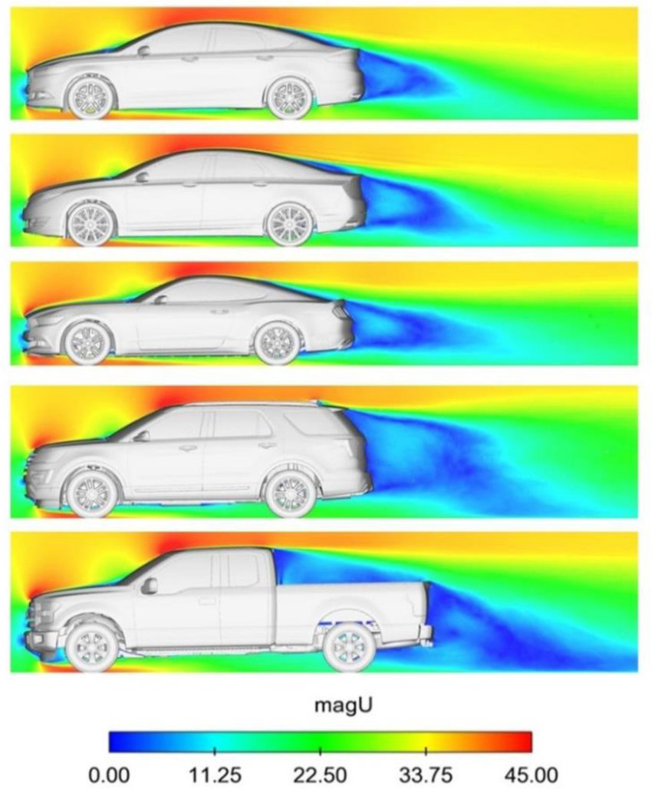
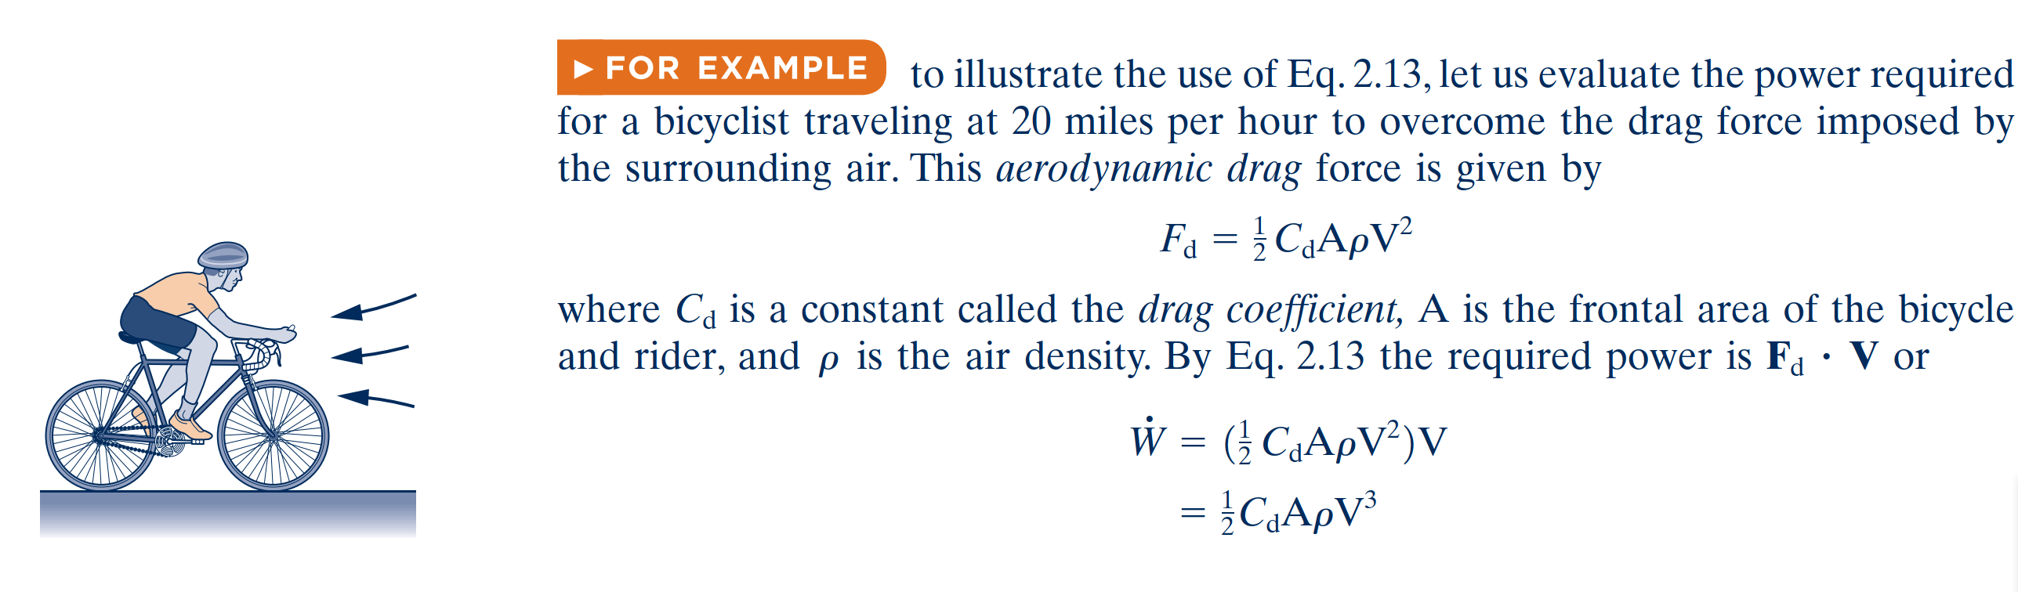
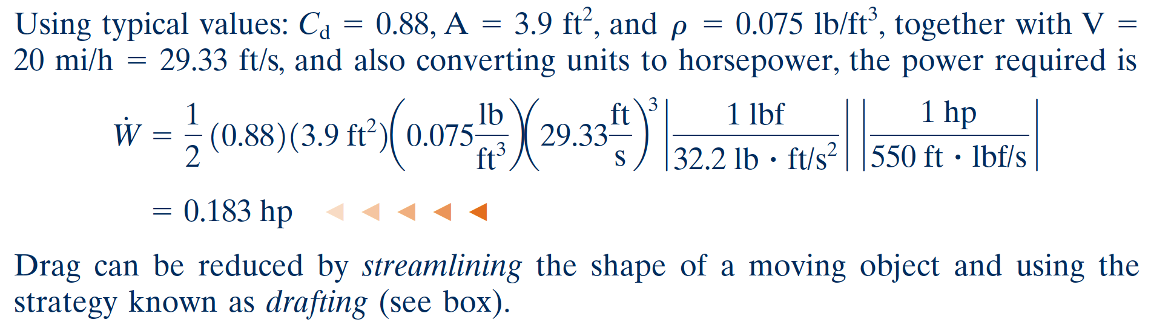
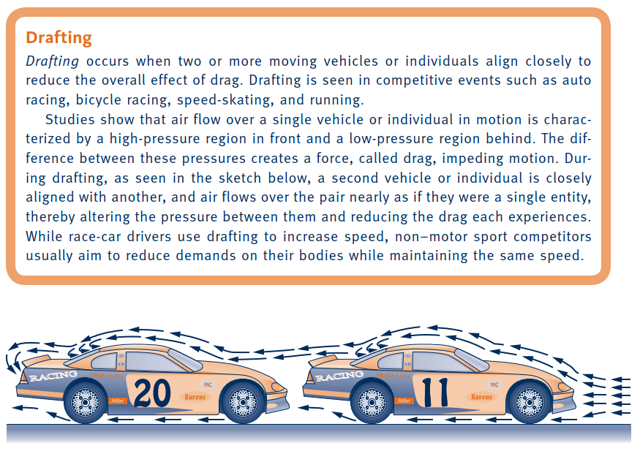
Broadening Our Understanding of Work

Slide 9
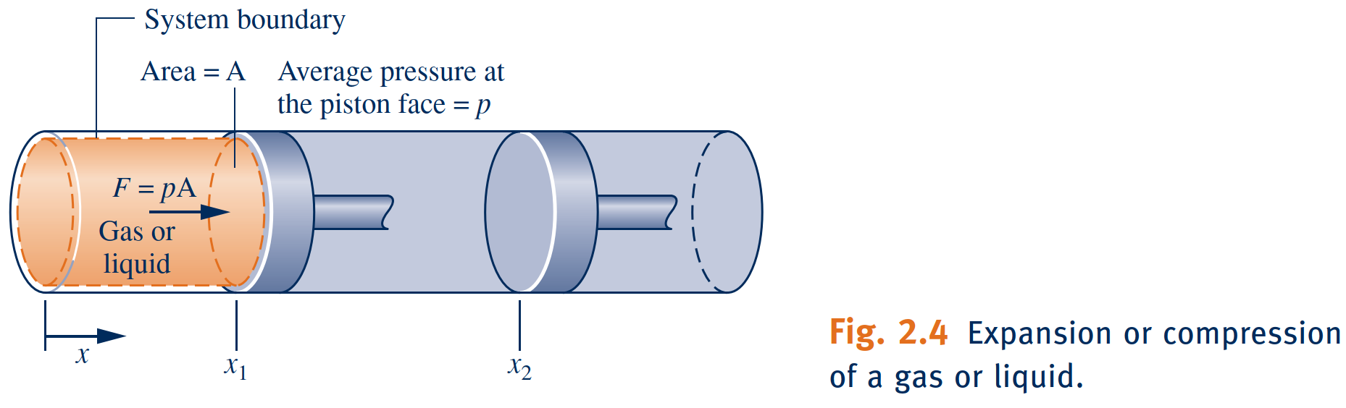
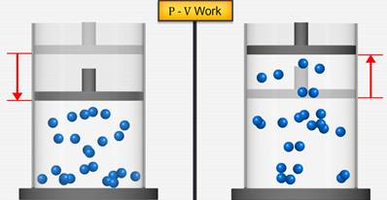
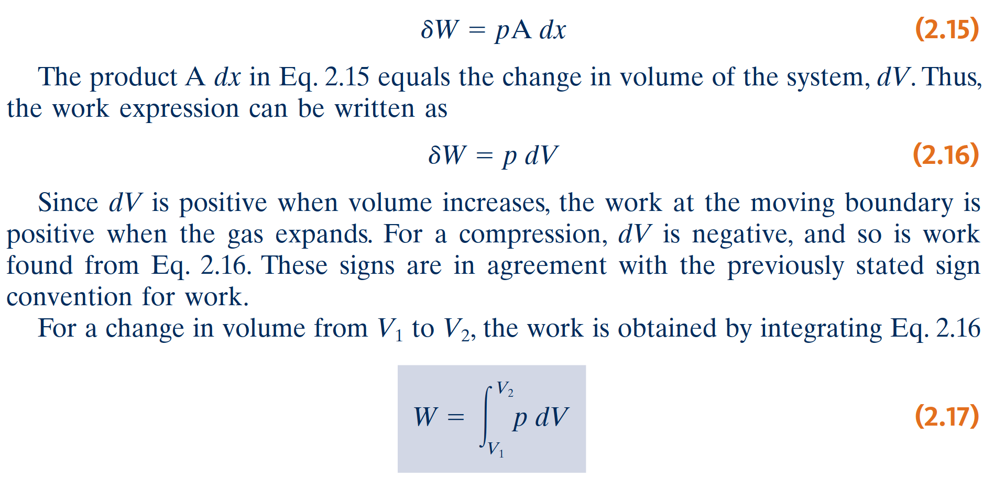
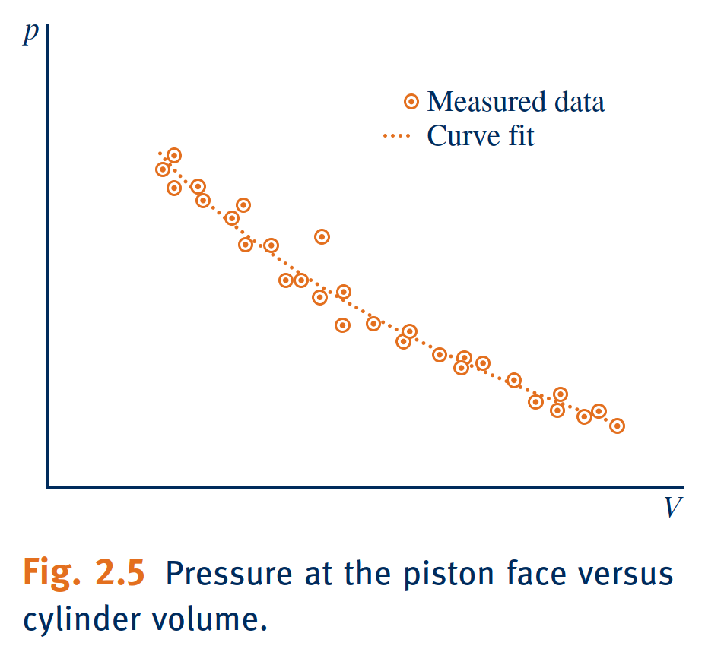
Modeling Expansion or Compression Work

Slide 10
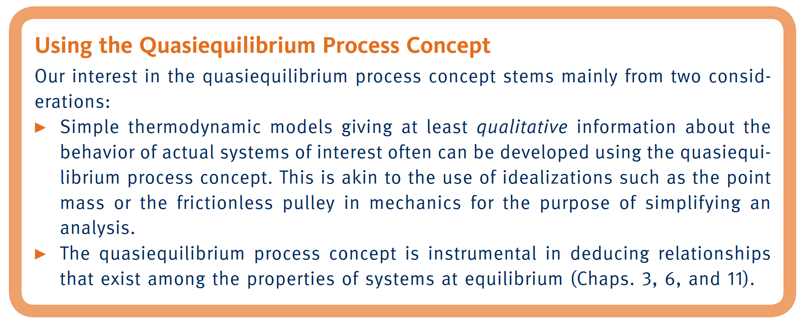
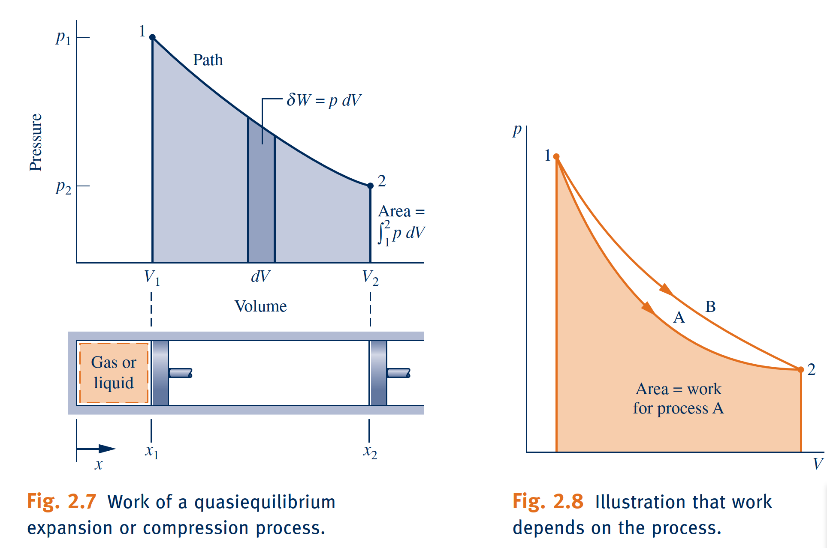
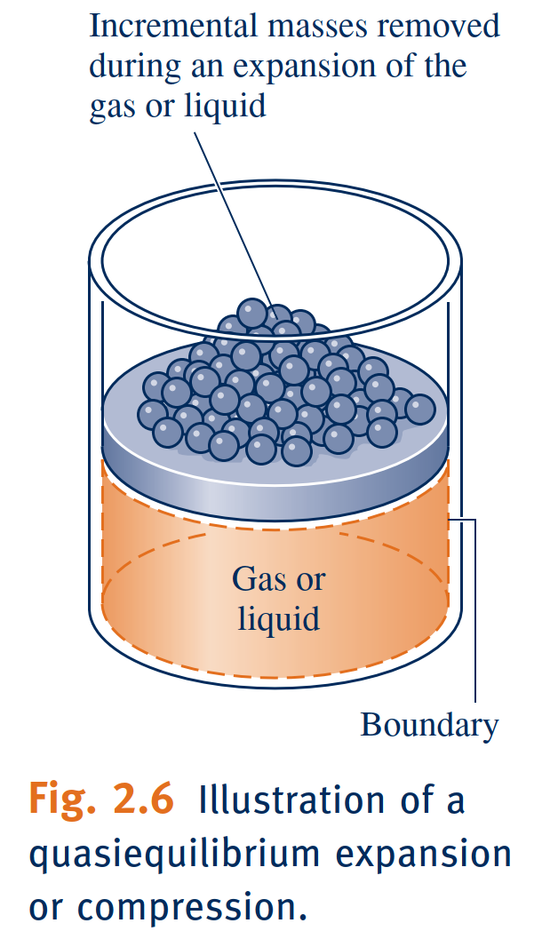
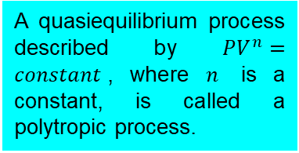
Expansion or Compression Work in Quasiequilibrium Processes
quasiequilibrium process
Processes are sometime modeled as an idealized type of process called a quasiequilibrium (or quasistatic) process. A quasiequilibrium process is one in which the departure from thermodynamic equilibrium is at most infinitesimal.
A quasiequilibrium process described by $PV^{n}=constant$, where $n$ is a constant, is called a polytropic process.
polytropic process

Slide 11
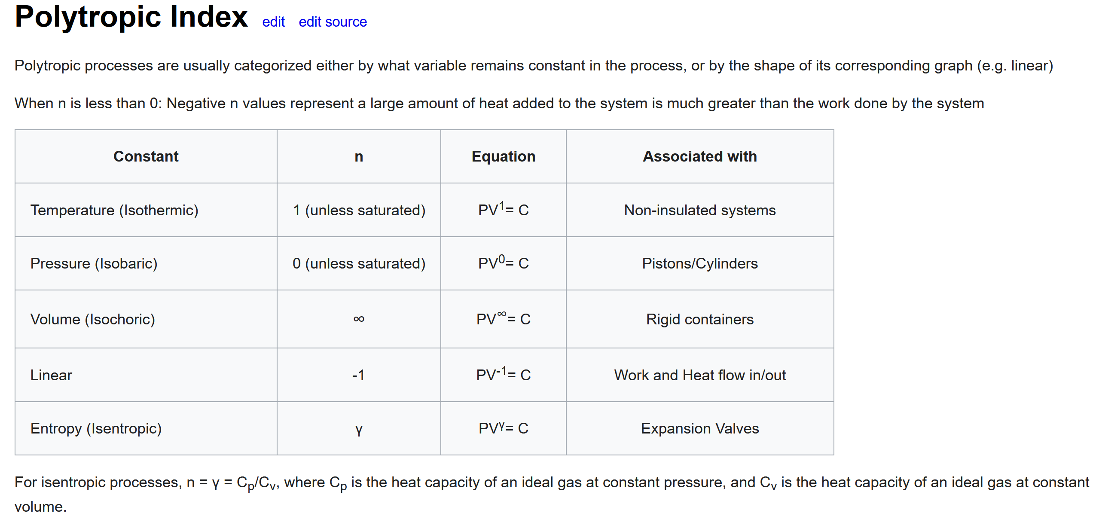
Expansion or Compression Work in Quasiequilibrium Processes
quasiequilibrium process
Processes are sometime modeled as an idealized type of process called a quasiequilibrium (or quasistatic) process. A quasiequilibrium process is one in which the departure from thermodynamic equilibrium is at most infinitesimal.
A quasiequilibrium process described by $PV^{n}=constant$, where $n$ is a constant, is called a polytropic process.
polytropic process

Slide 12
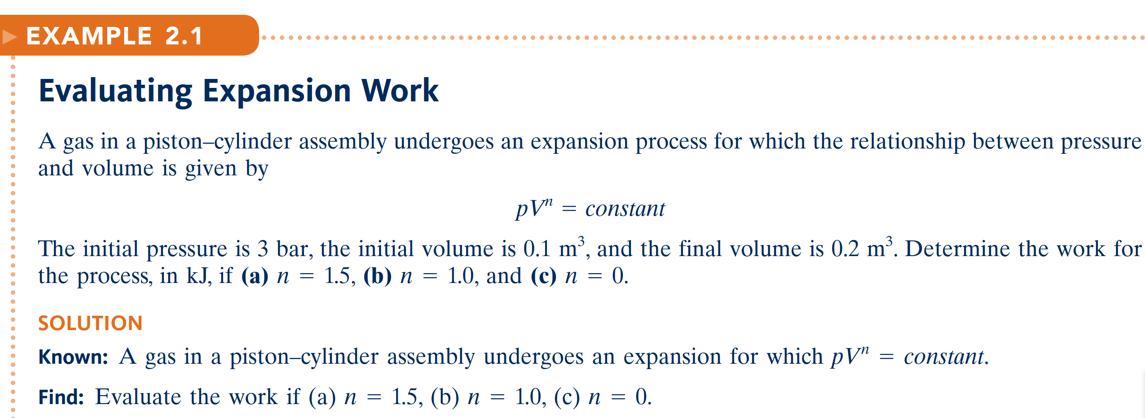
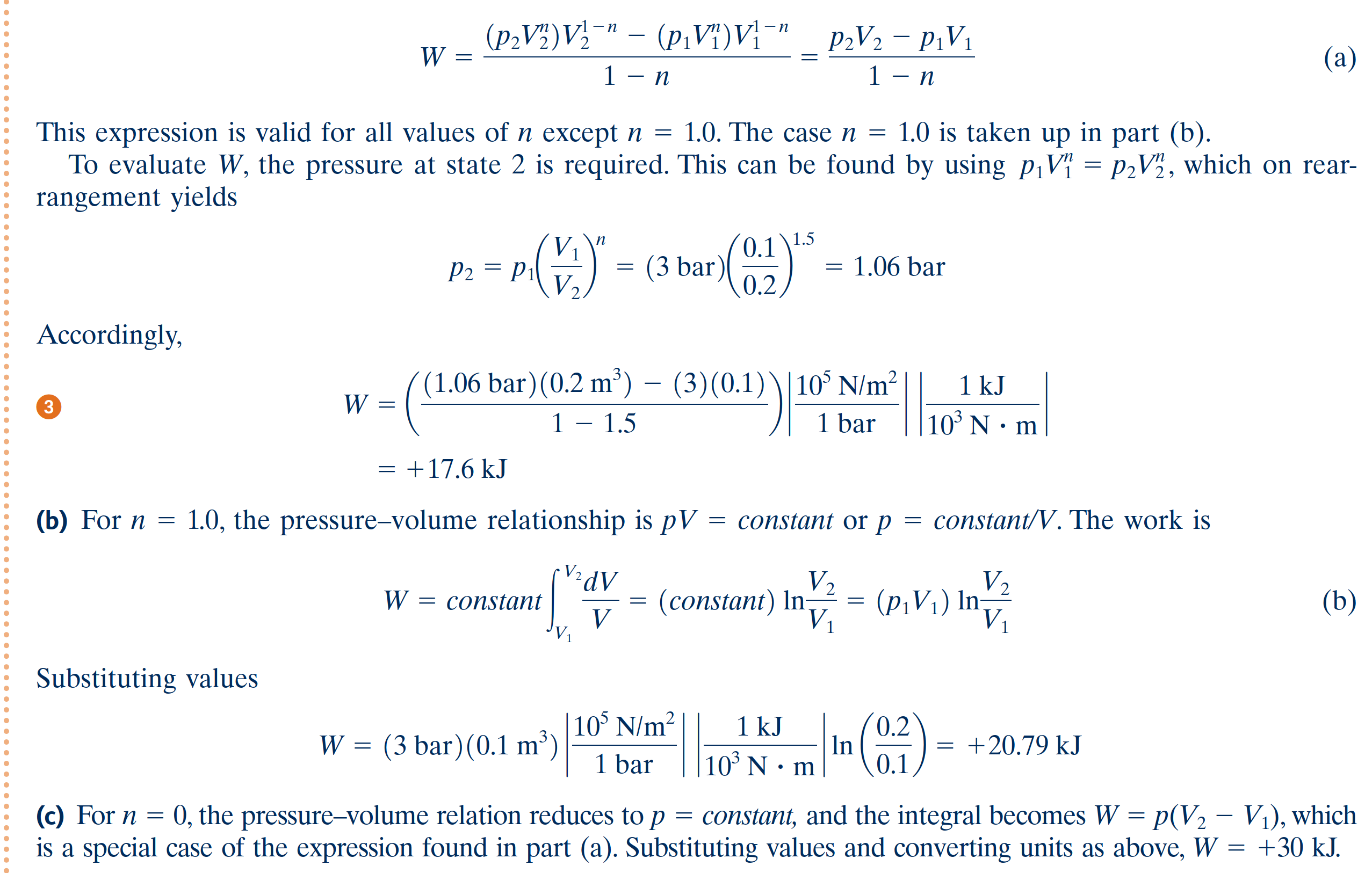
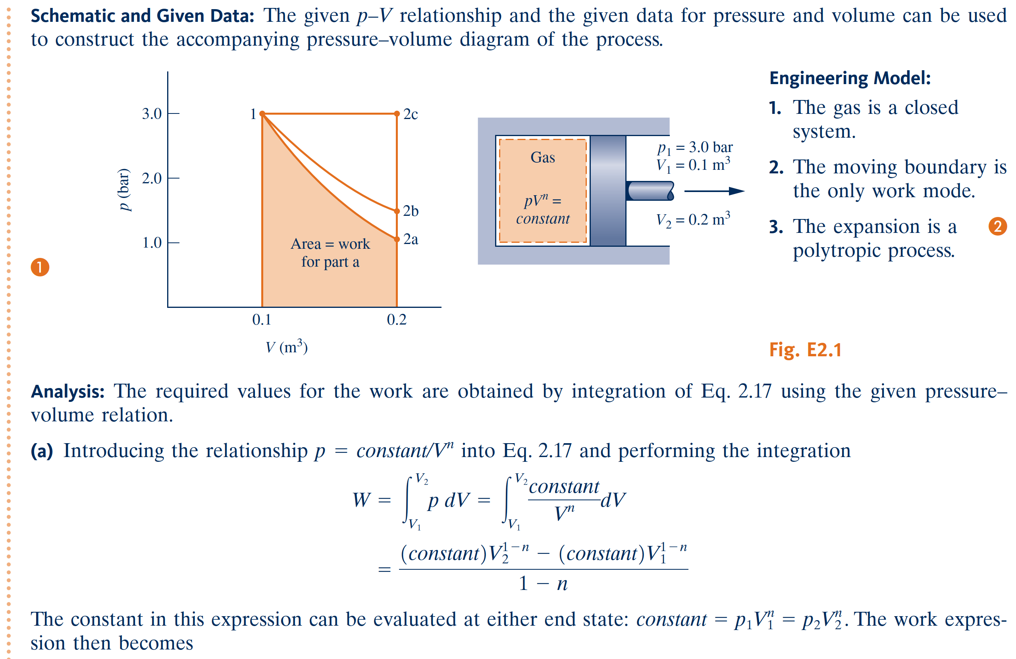
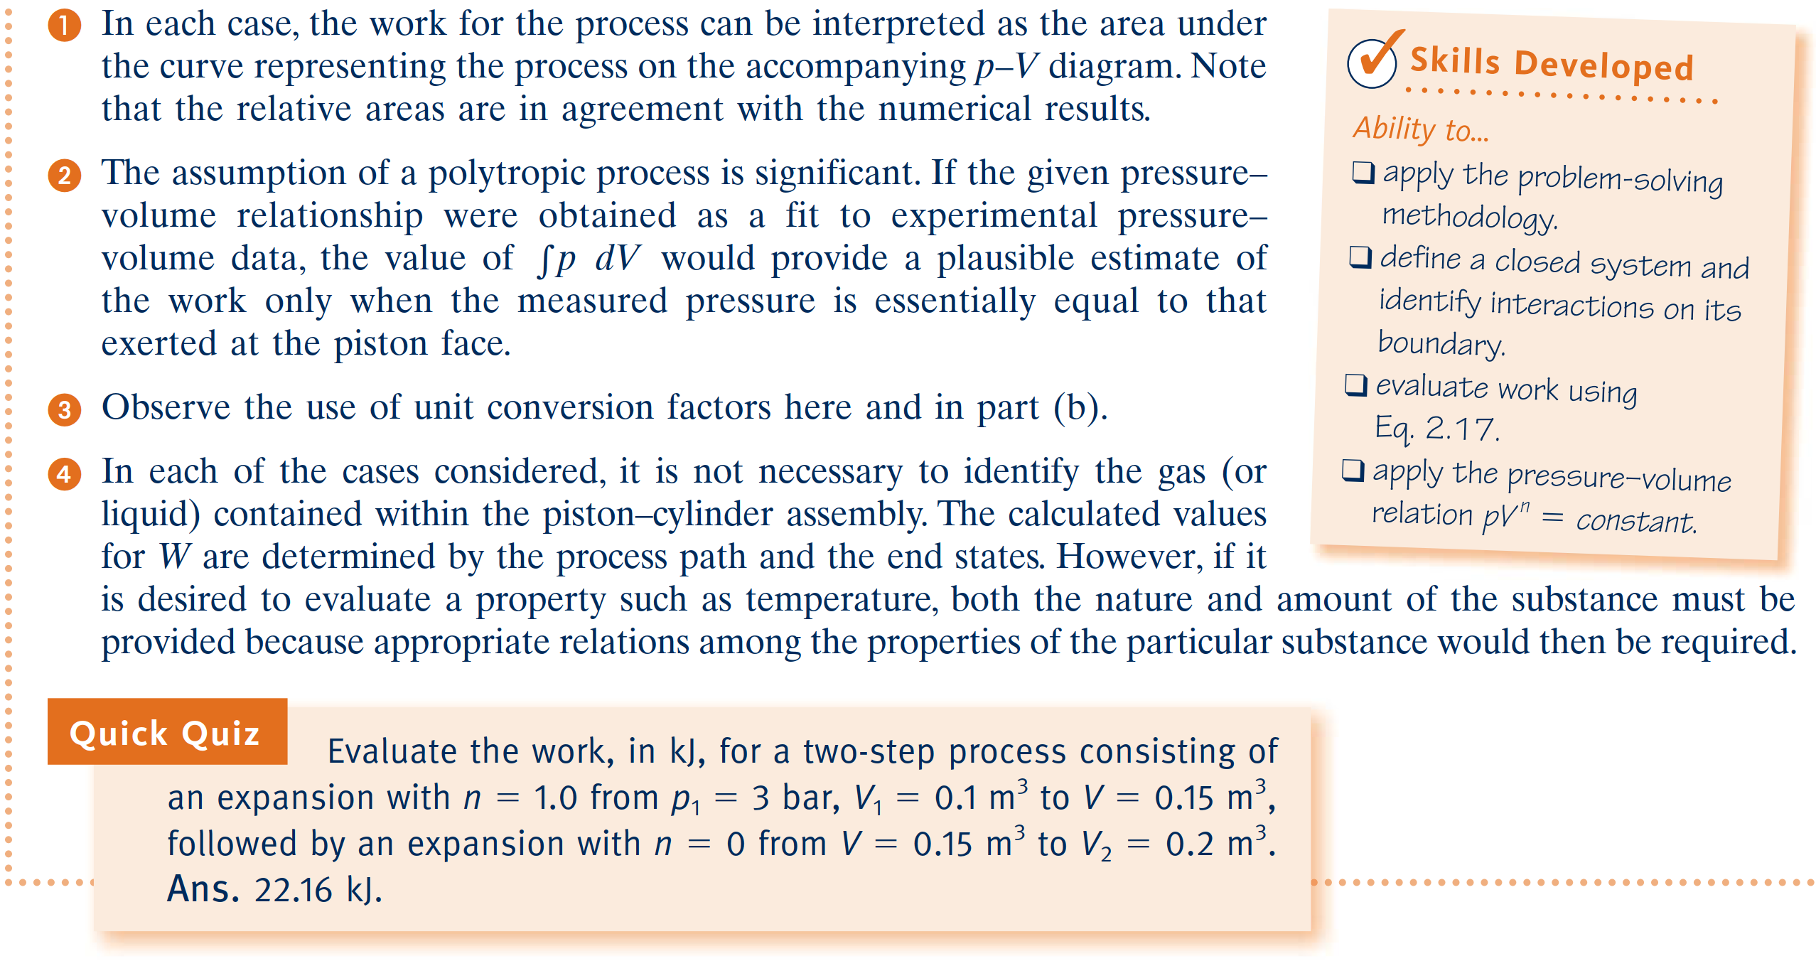
Review concepts of temperature, temperature scales, pressure, and absolute and gage pressure.

Slide 13
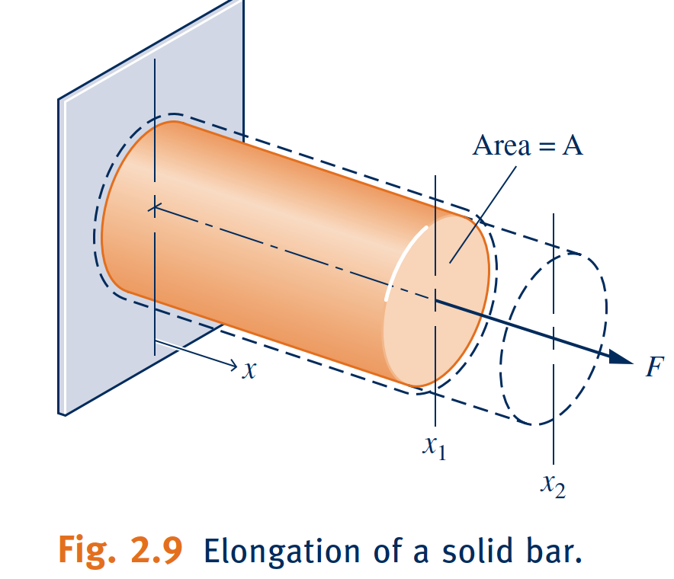
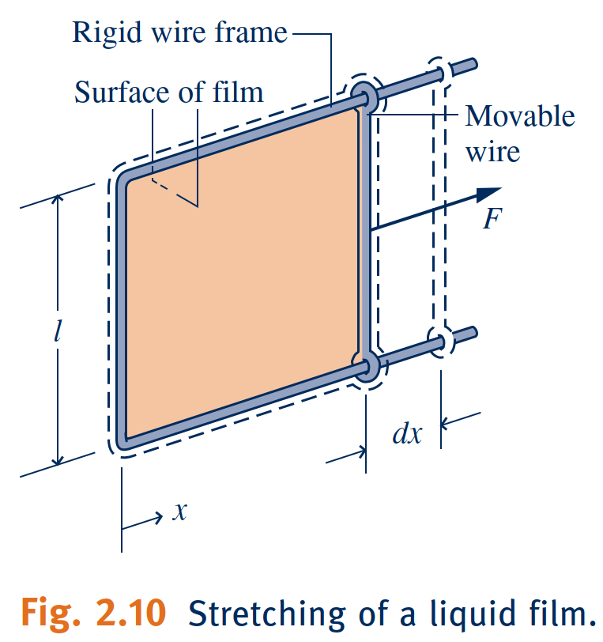
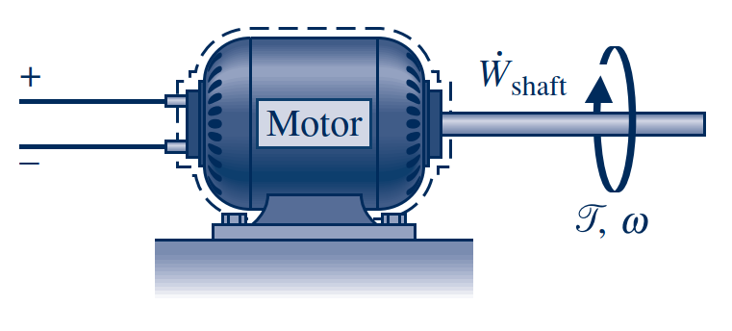
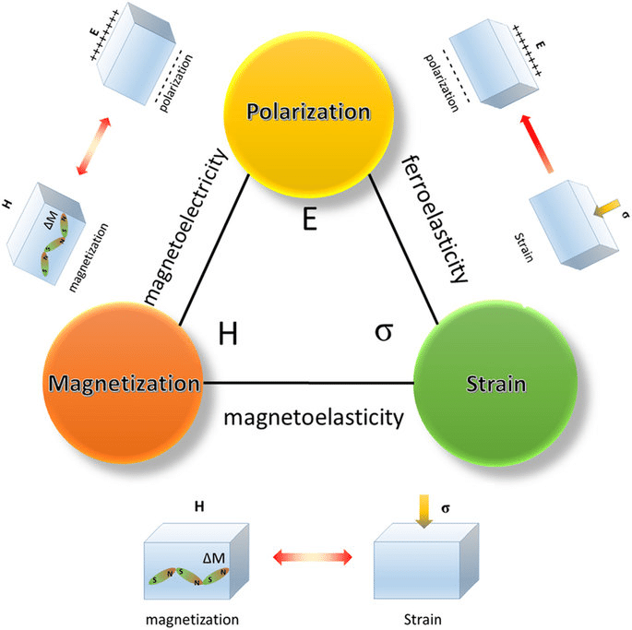
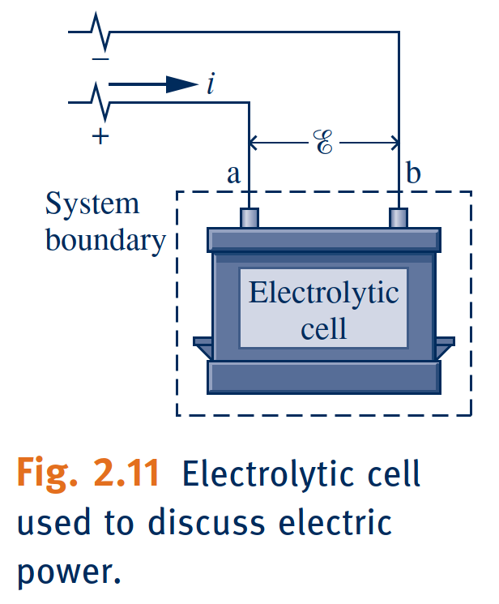
Further Examples of Work
Extension of a Solid Bar
Stretching of a Liquid Film
Power Transmitted by a Shaft
Electric Power
Work Due to Polarization or Magnetization

Slide 14
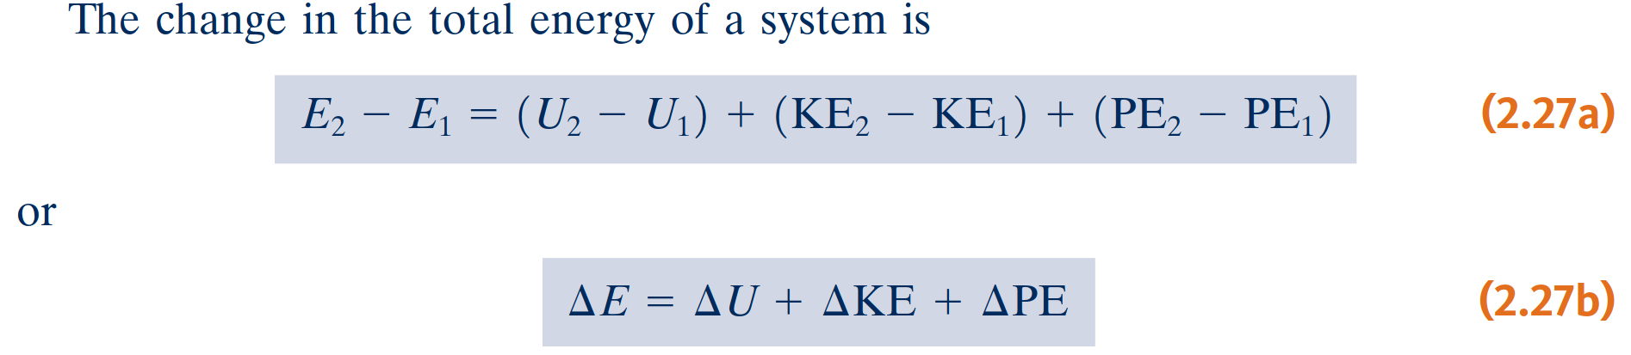
Broadening Our Understanding of Energy
In engineering thermodynamics, the change in the total energy of a system is considered to be made up of three macroscopic contributions.
One is the change in kinetic energy, associated with the motion of the system as a whole relative to an external coordinate frame.
Another is the change in gravitational potential energy, associated with the position of the system as a whole in Earth’s gravitational field.
All other energy changes are lumped together in the internal energy of the system.
Like kinetic energy and gravitational potential energy, internal energy is an extensive property of the system, as is the total energy.

Slide 15
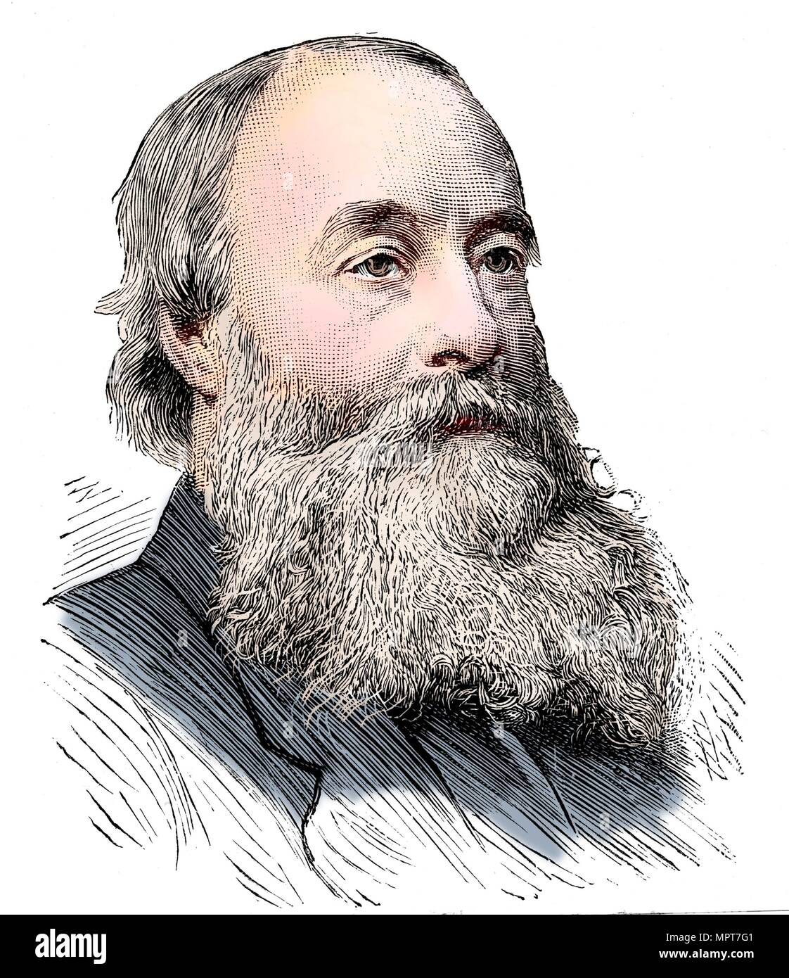
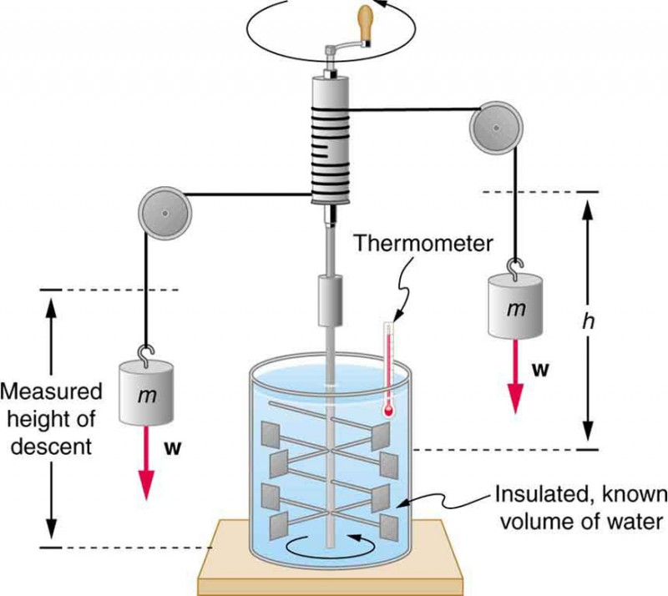
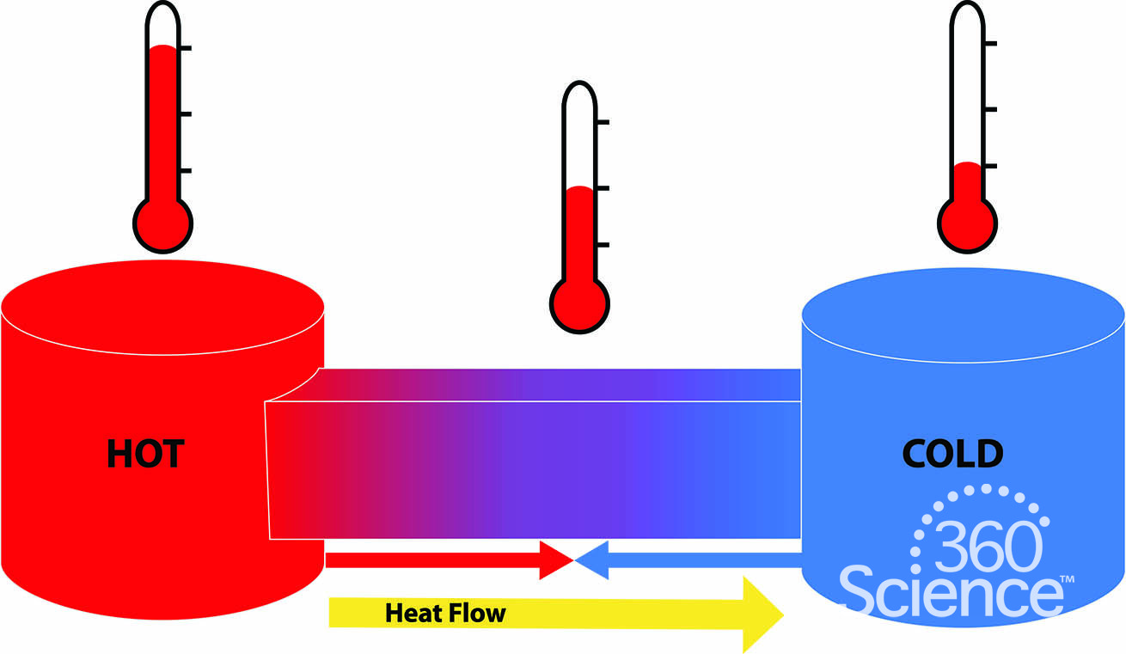
Energy Transfer by Heat
On the basis of experiment, beginning with the work of Joule in the early part of the 19th century, we know that energy transfers by heat are induced only as a result of a temperature difference between the system and its surroundings and occur only in the direction of decreasing temperature.

Slide 16
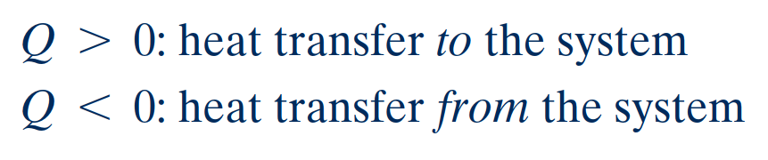
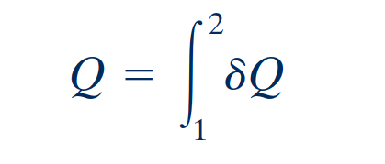
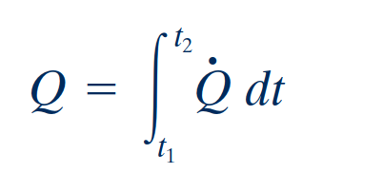
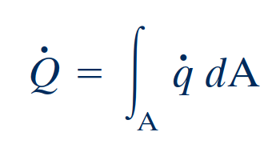
Sign Convention, Notation, and Heat Transfer Rate
sign convention for heat transfer
The symbol Q denotes an amount of energy transferred across the boundary of a system in a heat interaction with the system’s surroundings. Heat transfer into a system is taken to be positive, and heat transfer from a system is taken as negative.
heat is not a property
The value of a heat transfer depends on the details of a process and not just the end states. Thus, like work, heat is not a property, and its differential is written as σQ. The amount of energy transfer by heat for a process is given by the integral
rate of heat transfer
the amount of energy transfer by heat during a period of time can be found by integrating from time t₁ to time t₂. In some cases, it is convenient to use the heat flux, q, which is the heat transfer rate per unit of system surface area.

Slide 17
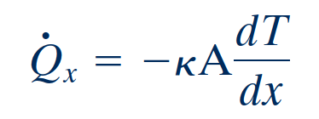
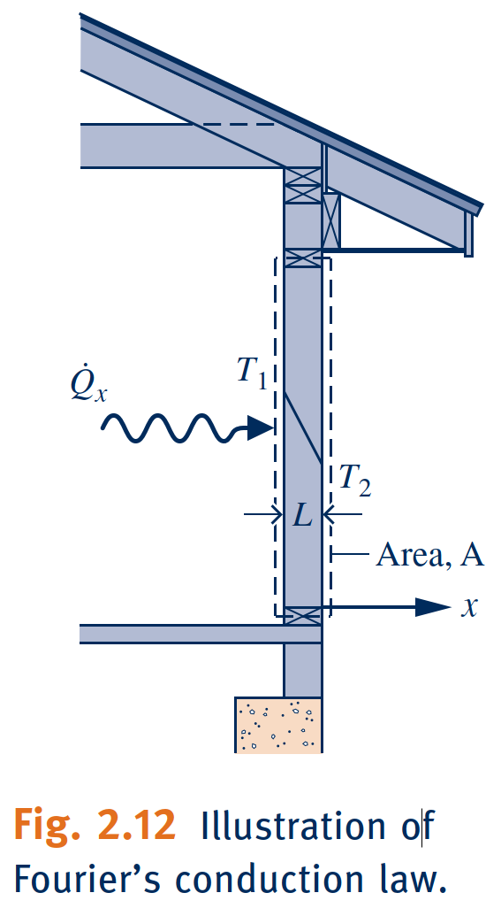
Heat Transfer Modes
Methods based on experiment are available for evaluating energy transfer by heat. These methods recognize two basic transfer mechanisms: conduction and thermal radiation.
Energy transfer by conduction can take place in solids, liquids, and gases. Conduction can be thought of as the transfer of energy from the more energetic particles of a substance to adjacent particles that are less energetic due to interactions between particles.
Conduction
Fourier’s law
The time rate of energy transfer by conduction is quantified macroscopically by Fourier’s
law.
where the proportionality constant k is a property called the thermal conductivity. The minus sign is a consequence of energy transfer in the direction of decreasing temperature.

Slide 18
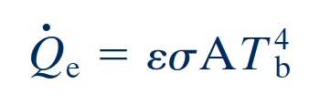
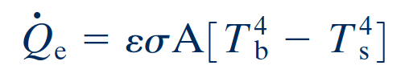
Heat Transfer Modes
Thermal radiation is emitted by matter as a result of changes in the electronic configurations of the atoms or molecules within it. The energy is transported by electromagnetic waves (or photons). Unlike conduction, thermal radiation requires no intervening medium to propagate and can even take place in a vacuum. Solid surfaces,
gases, and liquids all emit, absorb, and transmit thermal radiation to varying degrees.
Radiation
Stefan–Boltzmann law
The rate at which energy is emitted, ${\dot{Q}}_{e}$, from a surface of area $A$ is quantified mac-
roscopically by a modified form of the Stefan–Boltzmann law
which shows that thermal radiation is associated with the fourth power of the absolute temperature of the surface, T_{b}. The emissivity, ε, is a property of the surface that indicates how effectively the surface radiates 10 e 1.02 , and is the Stefan–Boltzmann constant:
net rate of radiant exchange
The net rate of radiant exchange between the smaller surface, whose area is A and emissivity is ${\dot{Q}}_{e}$, and the larger surroundings is

Slide 19
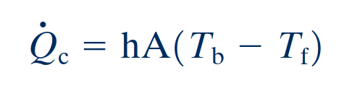


Heat Transfer Modes
Energy transfer between a solid surface at a temperature Tb and an adjacent gas or liquid at another temperature T_{f} plays a prominent role in the performance of many devices of practical interest. This is commonly referred to as convection.
Convection
Newton’s law of cooling
In this case, energy is transferred in the direction indicated by the arrow due to the combined effects of conduction within the air and the bulk motion of the air.
Where, a is the surface area and the proportionality factor h is called the heat transfer coefficient. The heat transfer coefficient is not a thermodynamic property. It is an empirical parameter that incorporates into the heat transfer relationship the nature of the flow pattern near the surface, the fluid properties, and the geometry.

Slide 20

Summary of the Heat Transfer Mechanism
Heat can be transferred in three different ways: conduction, convection, and radiation.
Conduction is the transfer of energy from the more energetic particles of a substance to the adjacent less energetic ones as a result of interactions between the particles, which is known as Fourier’s law of heat conduction.
Convection is the mode of energy transfer between a solid surface and the adjacent liquid or gas that is in motion, and it involves the combined effects of conduction and fluid motion, which known as Newton’s law of cooling.
Radiation is the energy emitted by matter in the form of electromagnetic waves (or photons) as a result of the changes in the electronic configurations of the atoms or molecules, which knows as Stefan-Boltzmann law.

Slide 21


First Law of Thermodynamics
The first law of thermodynamics, also known as the conservation of energy principle, provides a sound basis for studying the relationships among the various forms of energy and energy interactions.
Based on experimental observations, the first law of thermodynamics states that energy can be neither created nor destroyed during a process; it can only change forms. Therefore, every bit of energy should be accounted for during a process.

Slide 22





First Law of Thermodynamics
Energy Balance
BIOCONNECTIONS
Constant-volume calorimeter.

Slide 23





First Law of Thermodynamics
energy balance in differential form
time rate form of the energy balance
Since the time rate of change of energy is given by
or

Slide 24





Slide 25



Using the Energy Balance: Processes of Closed Systems

Slide 26



Using the Energy Balance: Processes of Closed Systems

Slide 27


Using the Energy Balance: Processes of Closed Systems

Slide 28






Slide 29



Using the Energy Balance: Processes of Closed Systems

Slide 30



Using the Energy Balance: Processes of Closed Systems

Slide 31





Energy Analysis of Cycles
thermodynamic cycle
A thermodynamic cycle is a sequence of processes that begins and ends at the same state.
Cycle Energy Balance
Systems undergoing cycles of the type shown in Fig. 2.17a deliver a net work transfer of energy to their surroundings during each cycle. Any such cycle is called a power cycle.
power cycle
The extent of the energy conversion from heat to work is expressed by the following ratio, commonly called the thermal efficiency:
thermal efficiency

Slide 32

Renewable Energy Technologies

Slide 33
Energy Storage
The need is widespread, including use with conventional fossil- and nuclear-fueled power plants, power plants using renewable sources like solar and wind, and countless applications in transportation, industry, business, and the home.
Electricity can be stored as internal energy, kinetic energy, and gravitational potential energy and converted back to electricity when needed.
Owing to thermodynamic limitations associated with such conversions, the effects of friction and electrical resistance for instance, an overall input-to-output loss of electricity is always observed
Among technically feasible storage options, economics usually determines if, when, and how storage is implemented.

Slide 34

Energy Storage

Slide 35

Energy & Environment
The conversion of energy from one form to another often affects the environment and the air we breathe in many ways, and thus the study of energy is not complete without considering its impact on the environment
The largest source of air pollution is the motor vehicles, and the pollutants released by the vehicles are usually grouped as hydrocarbons (HC), nitrogen oxides (NOx), and carbon monoxide (CO)
Ozone and Smog
Acid Rain
The Greenhouse Effect:
Global Warming and Climate Change

Slide 36





